Slide 1
Head up tilt test 의 적응증과 해석
Chang Hee Kwon, MD
Konkuk University Medical Center

Slide 2
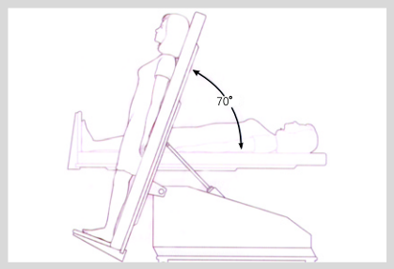
Head up tilt test
Method of tilt testing
• Patients should be fasted for 2–4 h before the test.
• Ensure a supine pre-tilt phase of ≥5 min when there is no
venous cannulation, and of ≥20 min when there is venous
cannulation.
• Tilt angle between 60º and 70º.
• Passive phase of tilt of ≥20 min duration and a maximum of 45 min.
• Use either sublingual nitroglycerin or intravenous isoproterenol for drug provocation if the passive phase is negative. The duration of the drug-challenge phase is 15–20 min:
• for nitroglycerin challenge, a fixed dose of 300–400 ug sublingually administered with the patient in the upright position;
• for isoproterenol challenge, an incremental infusion rate from 1 ug/min rising to 3 ug/min to increase average HR by about 20–25% over baseline.
• The test should be continued until complete LOC occurs or
completion of the protocol.
• Tilt tables have only one specific requirement: the tilt-down
time should be short (<15 s) as longer times increase the duration of precipitated asystole.
Tilt-table tests feature prolonged passive postural stress to determine whether patients have the autonomic substrate for vasovagal syncope.
KONKUK UNIVERSITY MEDICAL CENTER
European Heart Journal (2018) 39, e43–e80

Slide 3
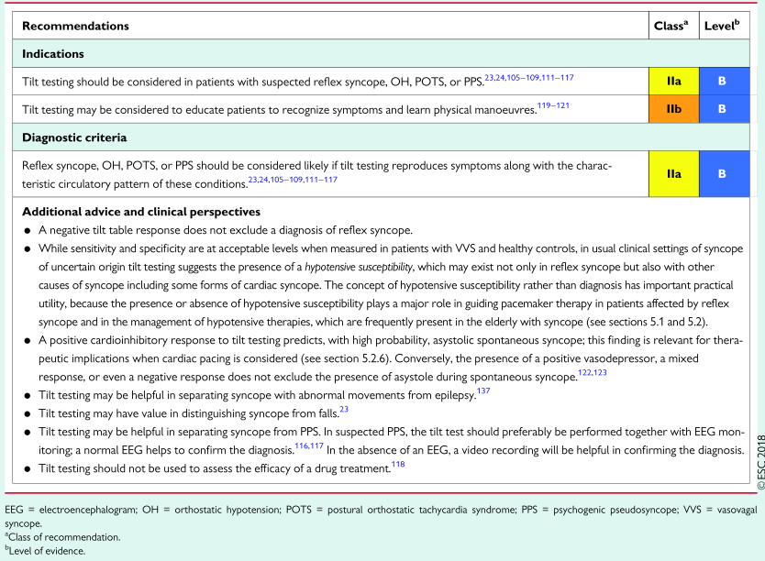
Indications of head up tilt test
2017 ACC/AHA/HRS Guidelines for Syncope
2018 ESC Guidelines for Syncope
J A C C V O L . 7 0 , N O . 5 , 2 0 1 7 A U G U S T 1 , 2 0 1 7 : e 3 9 – 1 1 0
European Heart Journal (2018) 00, 1–69
KONKUK UNIVERSITY MEDICAL CENTER

Slide 4
국내에서의 tilt-table test 의 추가 적응증
군 입대 전 남성의 병무청 제출용
이식형 사건 기록기 삽입 전 평가 (보험 조건)
KONKUK UNIVERSITY MEDICAL CENTER

Slide 5
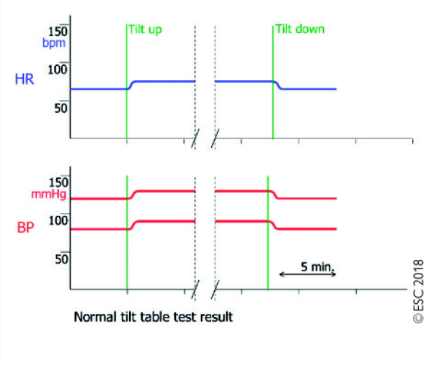
Head up tilt test 의 해석
The vasovagal reaction lasts roughly ≤3 min before causing LOC.
A decrease in systolic BP to <90 mmHg is associated with symptoms of impending syncope and to <60 mmHg is associated with syncope.
Normal tilt table test results
After head-up tilt, no change in BP or a slight increase of ≤10% occurs.
HR increases by ≤10% until patients are tilted back again.
KONKUK UNIVERSITY MEDICAL CENTER
European Heart Journal (2018) 39, e43–e80

Slide 6
Classiﬁcation of positive responses to tilt testing
제 1혼합형 (Type 1 Mixed)
실신 유발 당시 심박수가 하강하는데, 40회/분 이하로는 감소하지 않고, 그 이하로 감소하더라도 지속 시간은 10초 미만이며, 무수축 (asystole)은 없거나 3초 미만, 혈압은 심박수가 감소되기 전에 하강.
제 2A 무수축을 동반하지 않는 심장억제형 (Type 2 Cardioinhibition without asystole)
심박수는 10초 이상 40회/분 이하로 하강하는데, 3초 이상 지속되는 무수축은 없다. 혈압은 심박수가 감소되기 전에 하강.
제 2B 무수축을 동반하는 심장억제형 (Type 2 Cardioinhibition with asystole)
무수축이 3초 이상 지속됨. 혈압은 심박수 감소와 동시에 또는 심박수가 감소되기 전에 하강.
제 3 혈관억제형 (Type 3 Vasodepressor)
실신 당시 심박수가 검사 중 최고치에서 10% 이상 하강하지 않음.
예외 1. 심박수 변동부전 (Exception 1. Chronotropic incompetence)
기립경사 검사 중 심박수 상승이 없음 (예, 검사 전 심박수 보다 10% 미만의 심박수 상승).
예외 2. 과도한 심박수 상승 (Exception 2. Excessive heart rate rise; Postural Orthostatic Tachycardia Syndrome or POTS)
기립 시작에서부터 실신 전까지 검사 기간 내내 심박수의 지속적인 과도한 상승 (예, 130회/분 이상).
KONKUK UNIVERSITY MEDICAL CENTER
Europace (2004) 6, 467 - 537

Slide 7
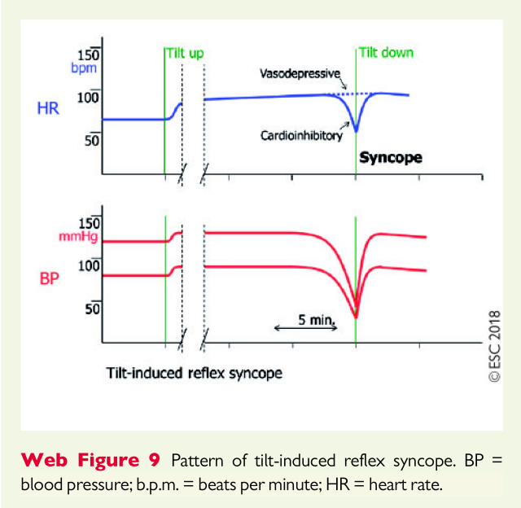
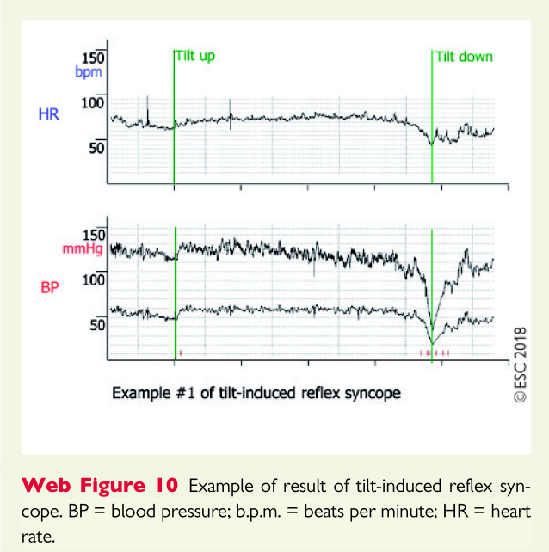
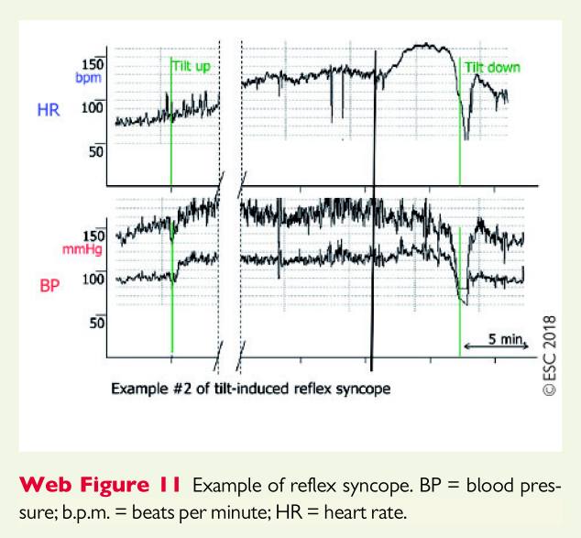
Pattern of tilt-induced reflex syncope
KONKUK UNIVERSITY MEDICAL CENTER
European Heart Journal (2018) 39, e43–e80

Slide 8
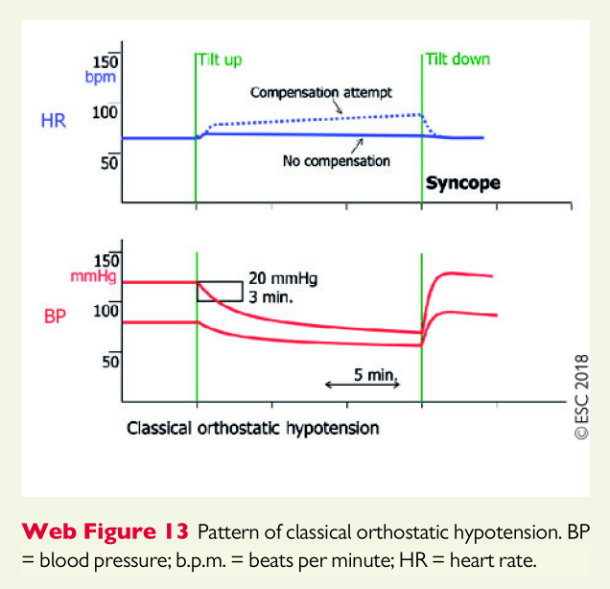
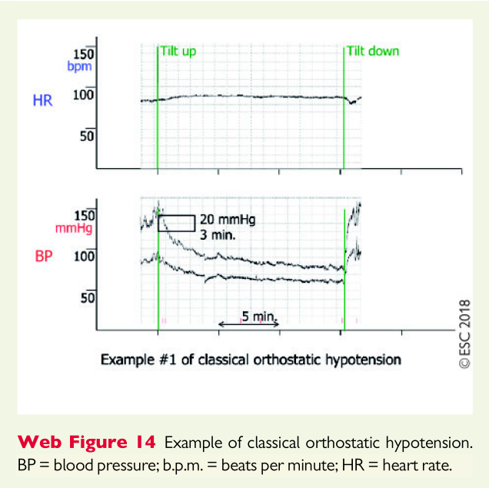
Classical orthostatic hypotension
KONKUK UNIVERSITY MEDICAL CENTER
European Heart Journal (2018) 39, e43–e80

Slide 9
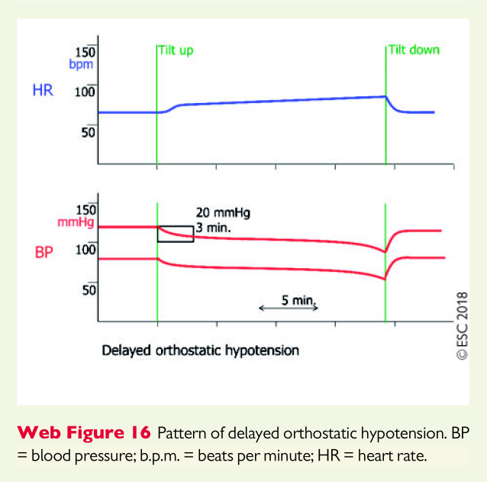
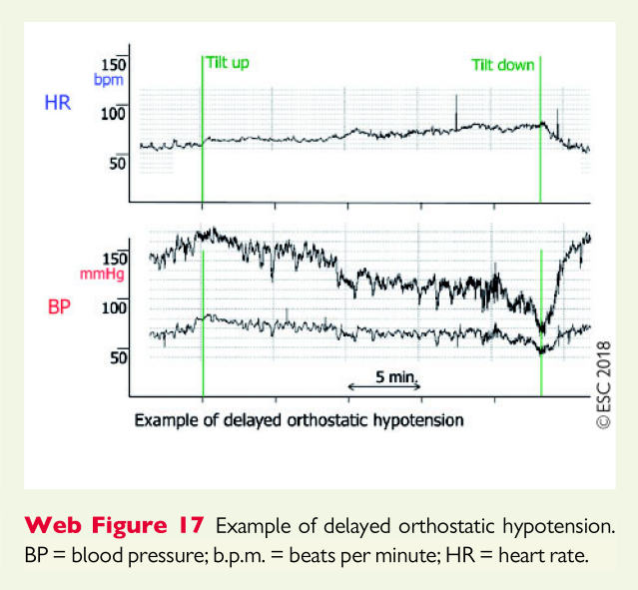
Delayed orthostatic hypotension
KONKUK UNIVERSITY MEDICAL CENTER
European Heart Journal (2018) 39, e43–e80

Slide 10
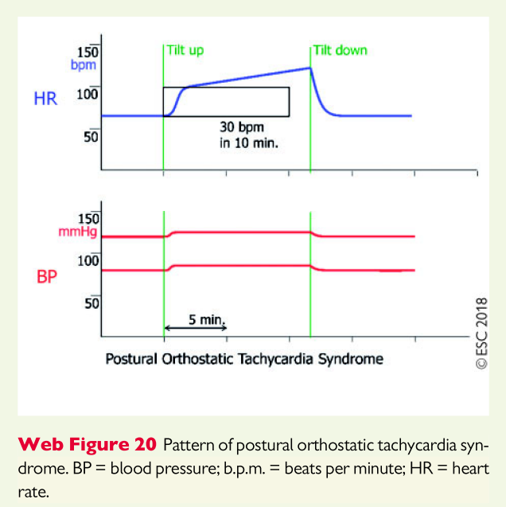
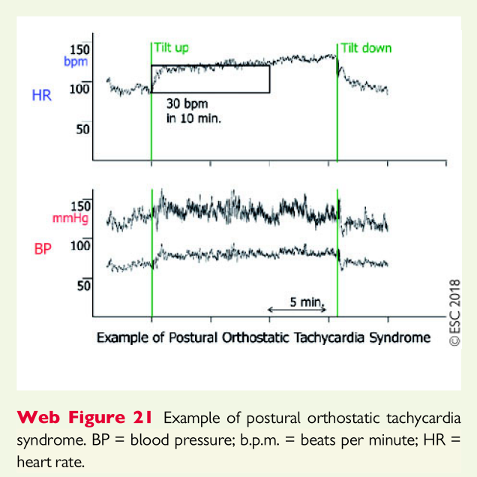
Postural Orthostatic Tachycardia Syndrome
POTS can only be diagnosed in the absence of OH
KONKUK UNIVERSITY MEDICAL CENTER
European Heart Journal (2018) 39, e43–e80

Slide 11
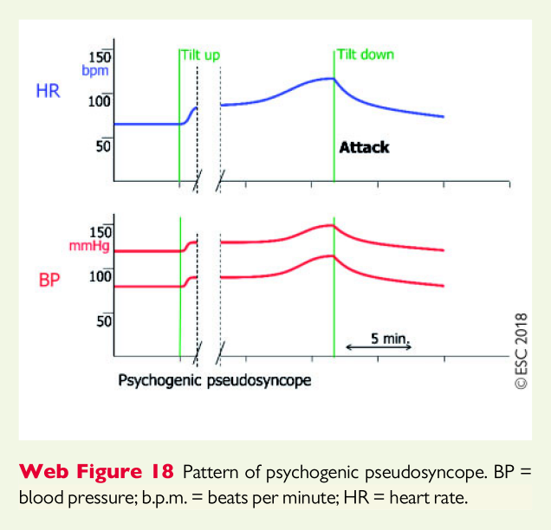
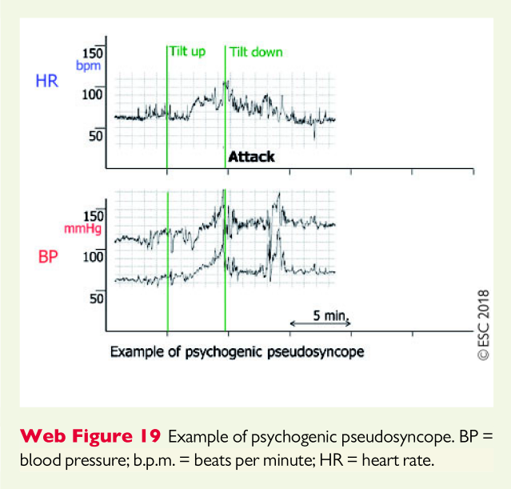
Psychogenic pseudosyncope
KONKUK UNIVERSITY MEDICAL CENTER
European Heart Journal (2018) 39, e43–e80

Slide 12
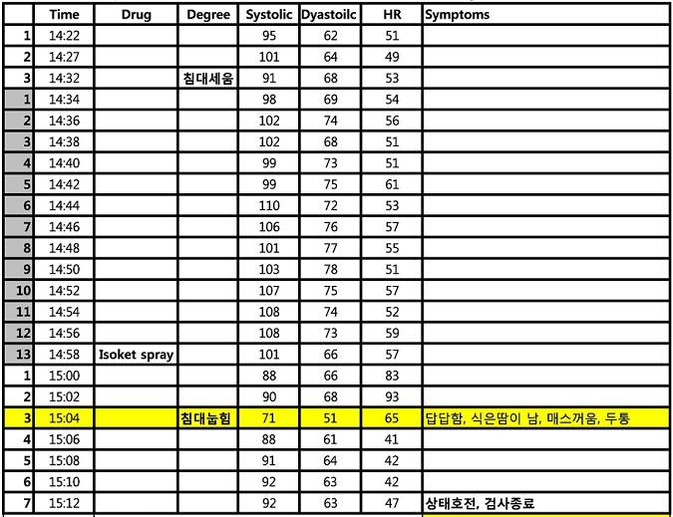
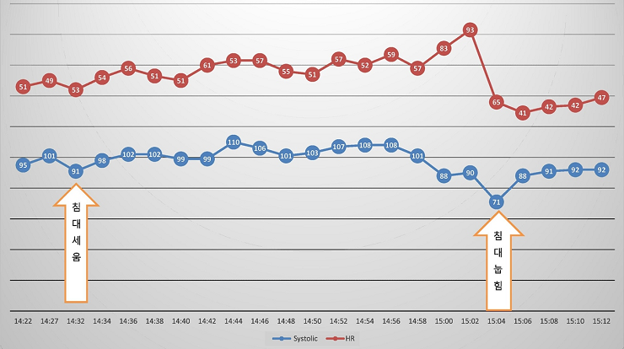
Case 1. F/64, c/c: recurrent syncope
☞ Type 1 mixed pattern
KONKUK UNIVERSITY MEDICAL CENTER
# 02158696

Slide 13
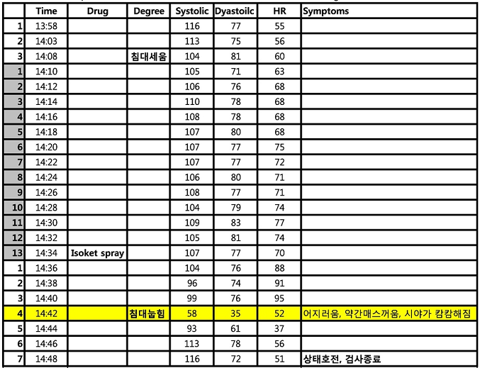
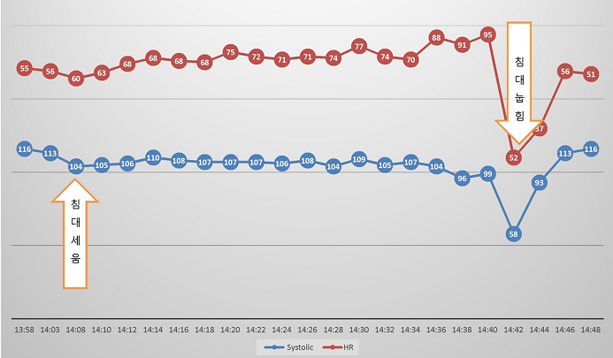
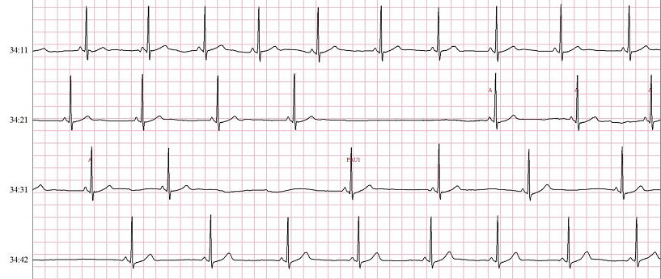
Case 2. F/24, c/c: syncope
☞ Type 2B cardioinhibitory pattern
KONKUK UNIVERSITY MEDICAL CENTER
# 00940473

Slide 14
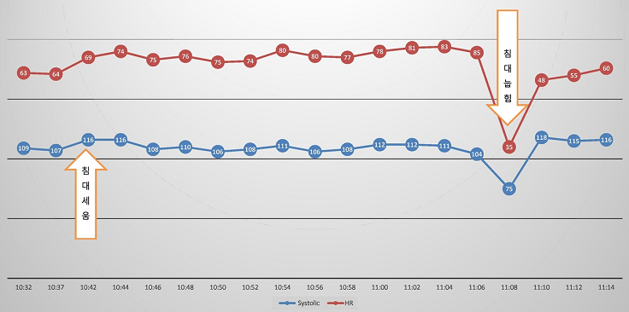
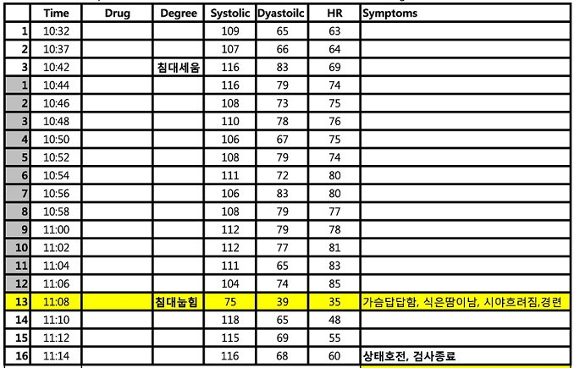
Case 3. F/27, c/c: syncope
☞ Type 2B cardioinhibitory pattern
KONKUK UNIVERSITY MEDICAL CENTER
# 01992557

Slide 15
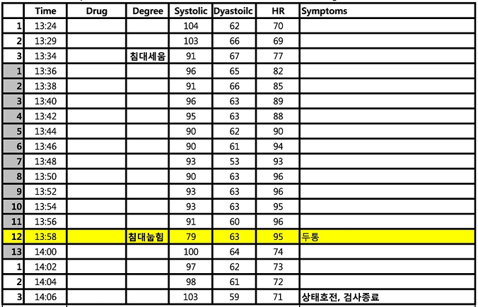
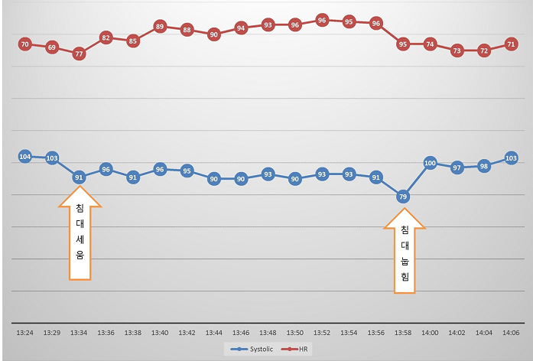
Case 4. M/66, c/c: syncope
☞ Type 3 vasodepressor pattern
KONKUK UNIVERSITY MEDICAL CENTER
# 02668546

Slide 16
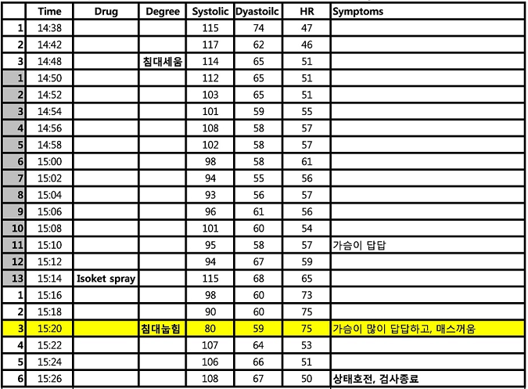
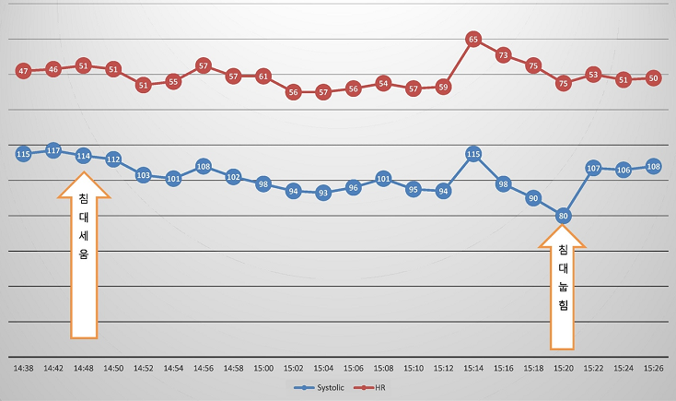
Case 5. F/62, c/c: syncope
☞ Type 3 vasodepressor pattern
KONKUK UNIVERSITY MEDICAL CENTER
# 01620755

Slide 17
Summary
Indication of Head up tilt test
For patients with suspected reflex syncope, OH, POTS, or PPS.
Interpretation of Head up tilt test
Positive findings : systolic BP to <90 mmHg is associated with symptoms of impending syncope and to <60 mmHg is associated with syncope.
Classification
Type 1 Mixed
Type 2A or 3B Cardioinhibitory
Type 3 Vasodepressor
KONKUK UNIVERSITY MEDICAL CENTER

Slide 18
Thank you for your kind attention!
KONKUK UNIVERSITY MEDICAL CENTER

